Slide 1
Laboratory practices
By: Mašek Lukáš & bence balázs Tóth

Slide 2
Parts of presentation
1/ Mircrobiological analysis of the diary products
by: Bence Balázs Tóth
2/ Determination of total water hardness via chelatometry
by: Mašek Lukáš

Slide 3
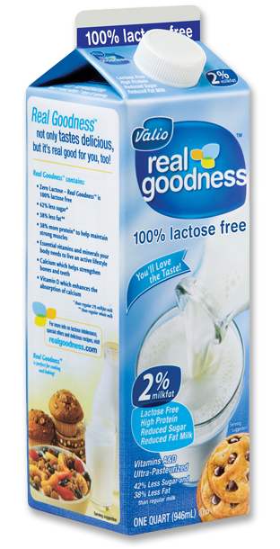
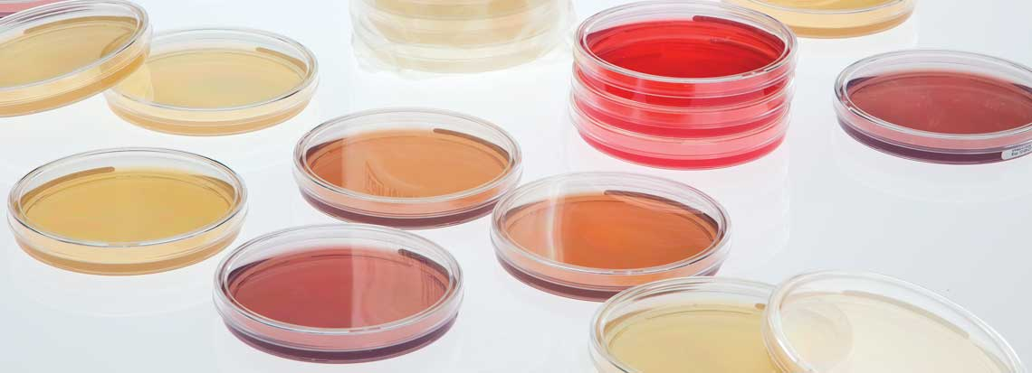
1/ Mircrobiological analysis of the diary products
Overall goal of the experiment
- To determine the number of microorganism present in diary products.
Accomplished by:
- Counting the amount of grown colonies on the media plate

Slide 4
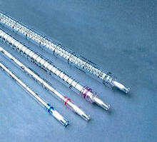
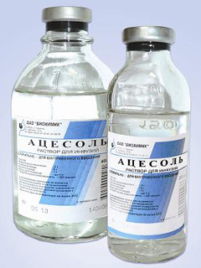
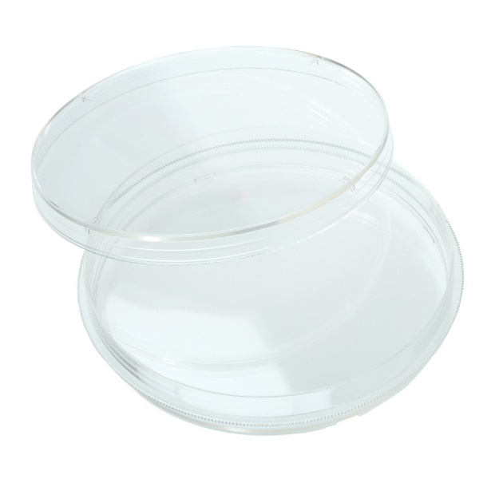
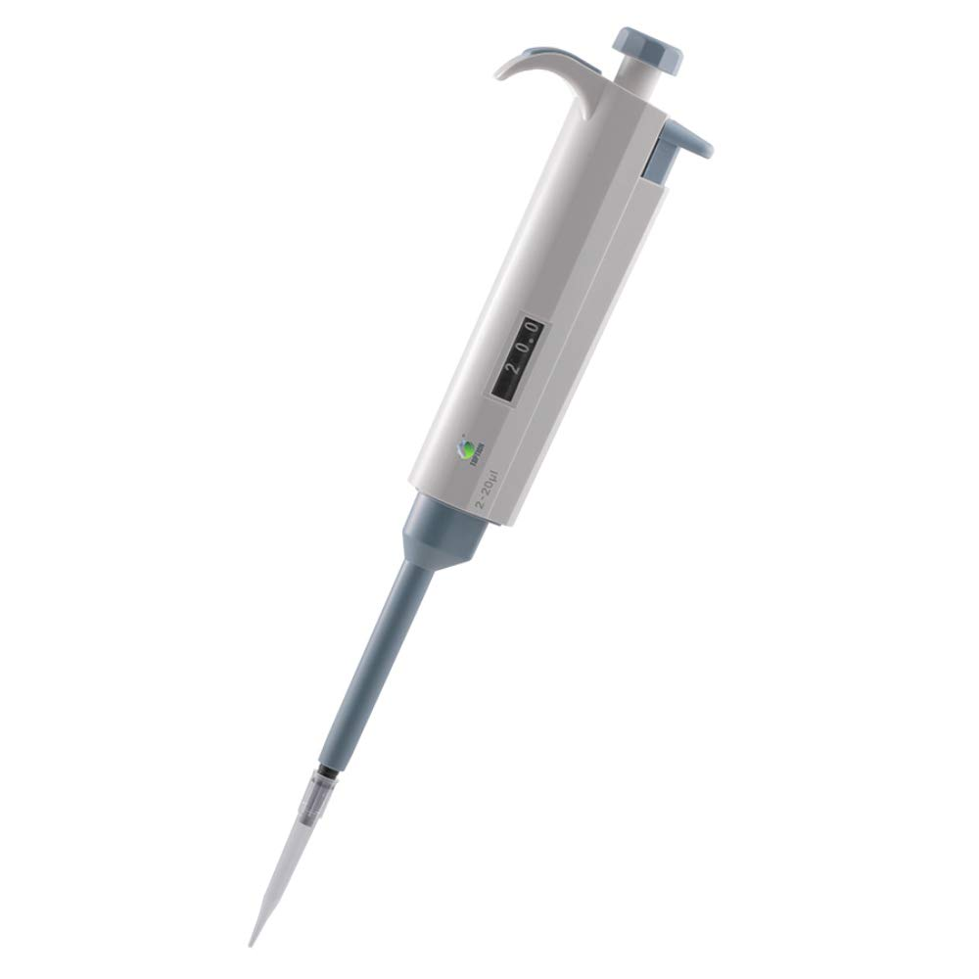
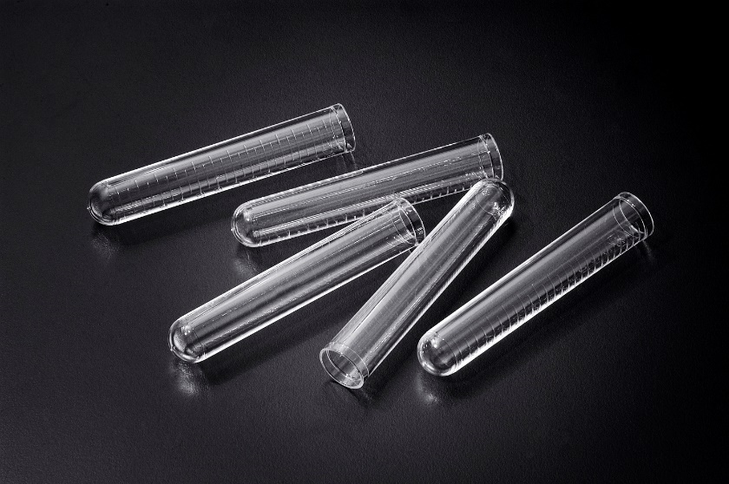
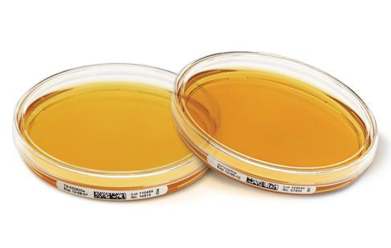
Required equipment
Diary product:
- Milk
Chemicals:
- GTKA agar medium, physiological solution
Tools
- Petri dishes (2x), Test tubes (3x), Pipettes (1ml and 10ml and 100 µl ones), Microbiological hockey stick

Slide 5
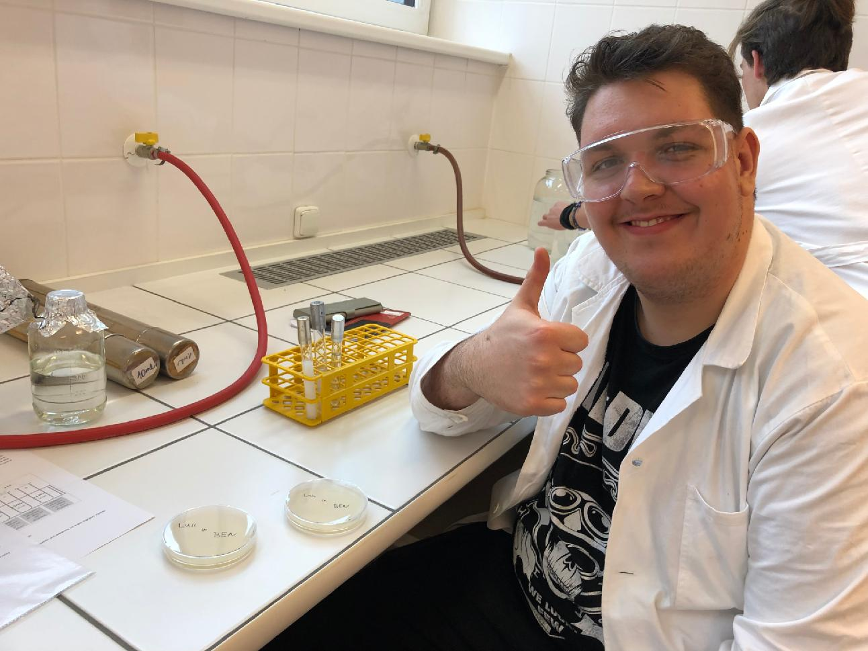
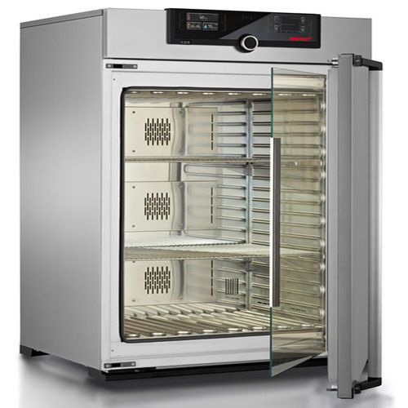
Process
(1) Take out 1ml of milk in a pipette
(2) Put the 1ml of milk in a test tube with 9ml of Physicological solution and shake the mixture together (dilution is now 10⁻¹)
(3) Dilute the mixture two more times (to 10⁻² and 10⁻³)
(4) Spread the GTKA agar solution in 2 petri dishes and leave it to stiffen
(5) Inoculum a pair of petri dishes with GTKA agar medium by the 100 µl 10⁻³ milk sample
(6) Spread it with the microbiological hockey stick
(7) Repeat step 5 and 6 one more time
(8) Put the two petri dishes in the incubator for 48 hour on 37 degrees celsius
(9) See the results after 48 hours.

Slide 6
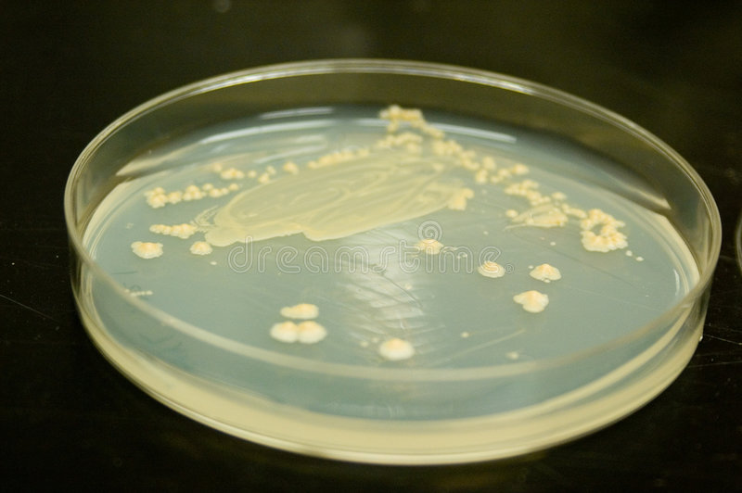
Results
The microorganisms had multiplied in number and grown all over the cultur plate.

Slide 7
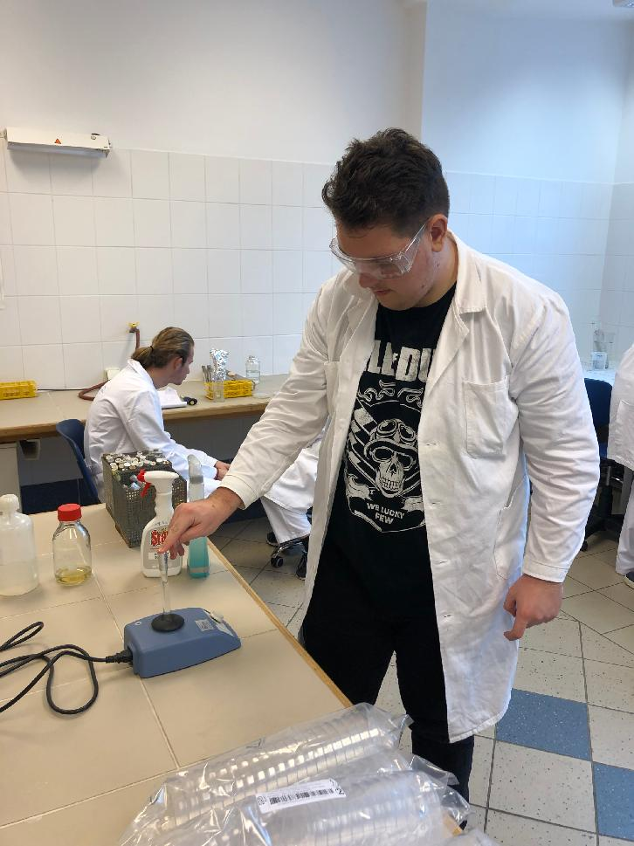
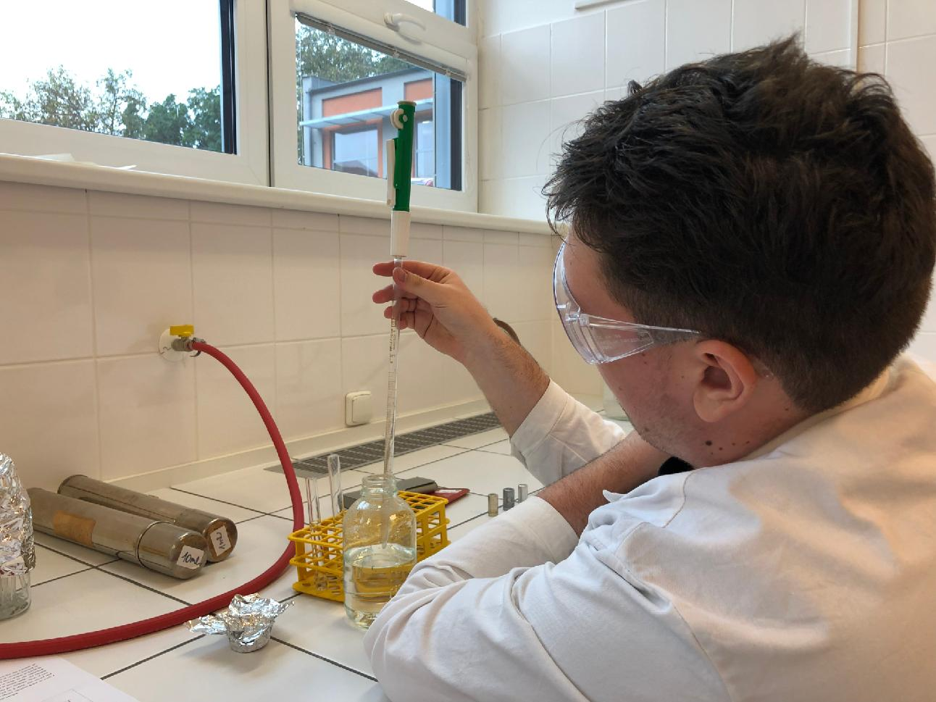
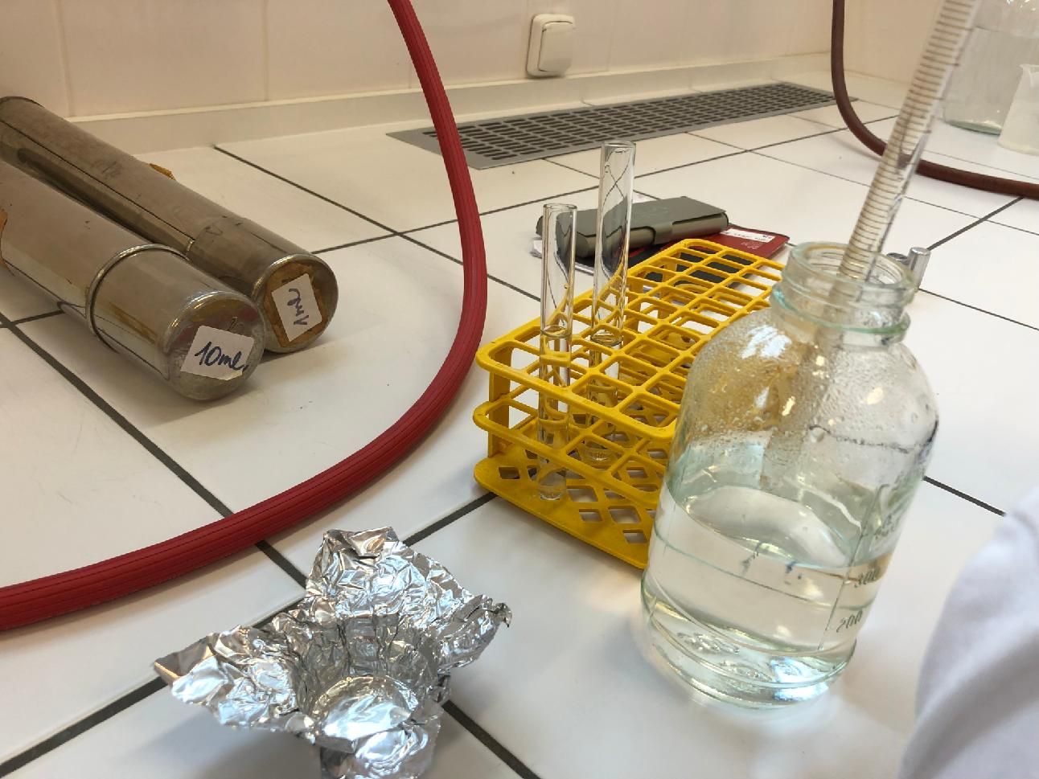
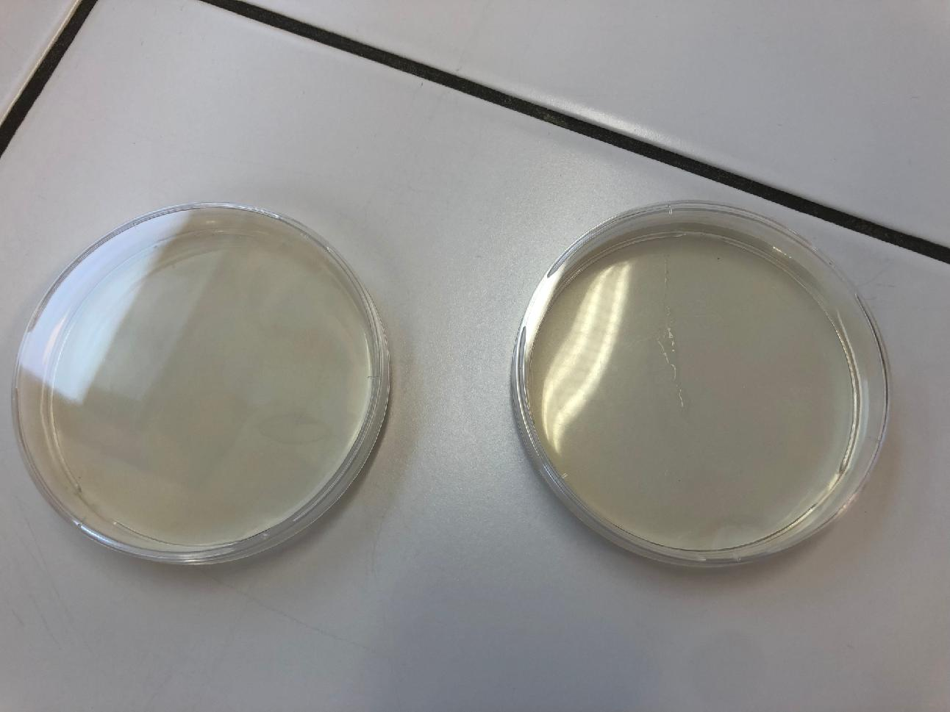
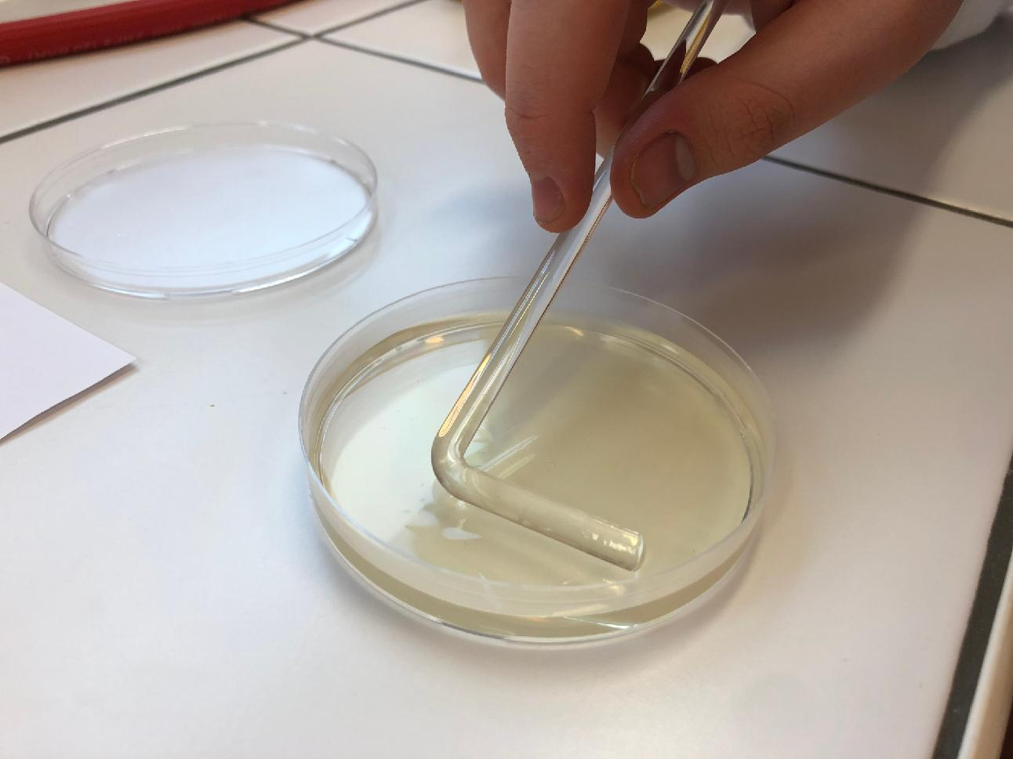

Slide 8
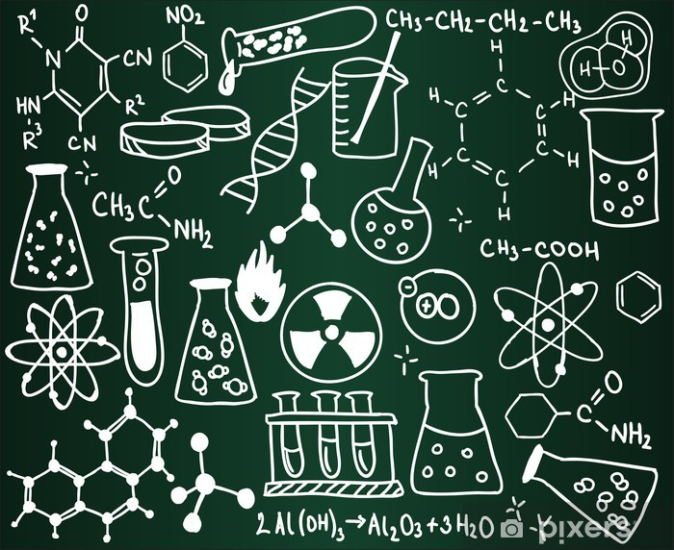
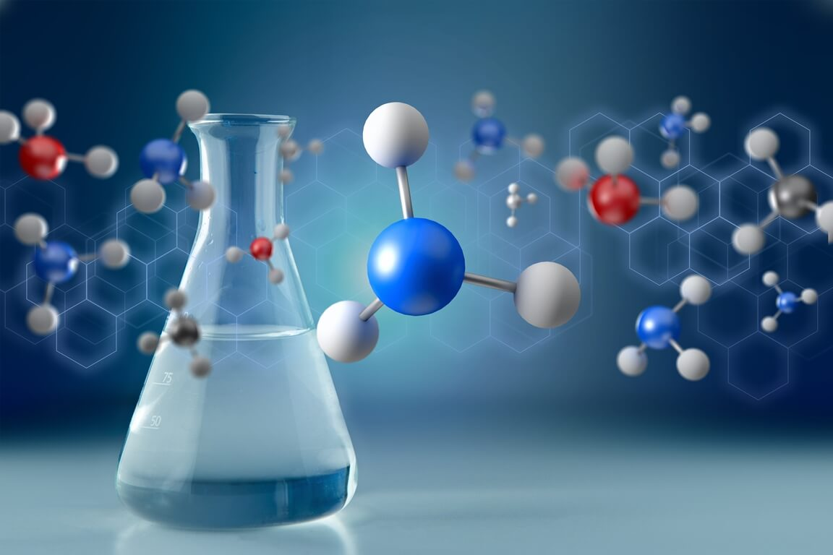
2/ Determination of total water hardness via chelatometry
Overall goal of the experiment
- Determine in mmol.l⁻¹ the total water hardness.
- Determine in mg.l⁻¹ the calcium and magnesium content in drinking water

Slide 9
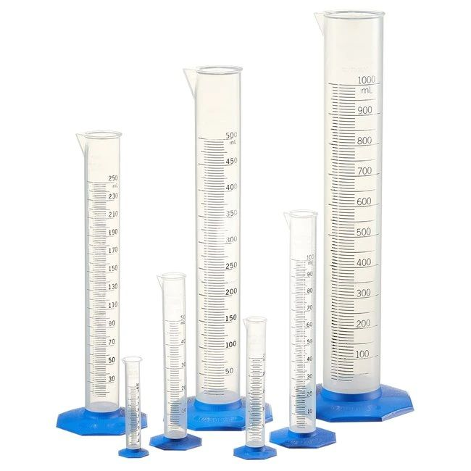
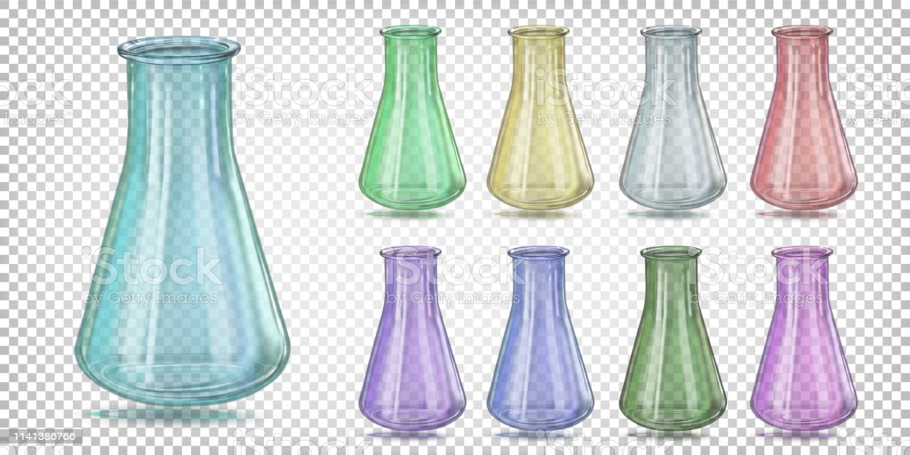
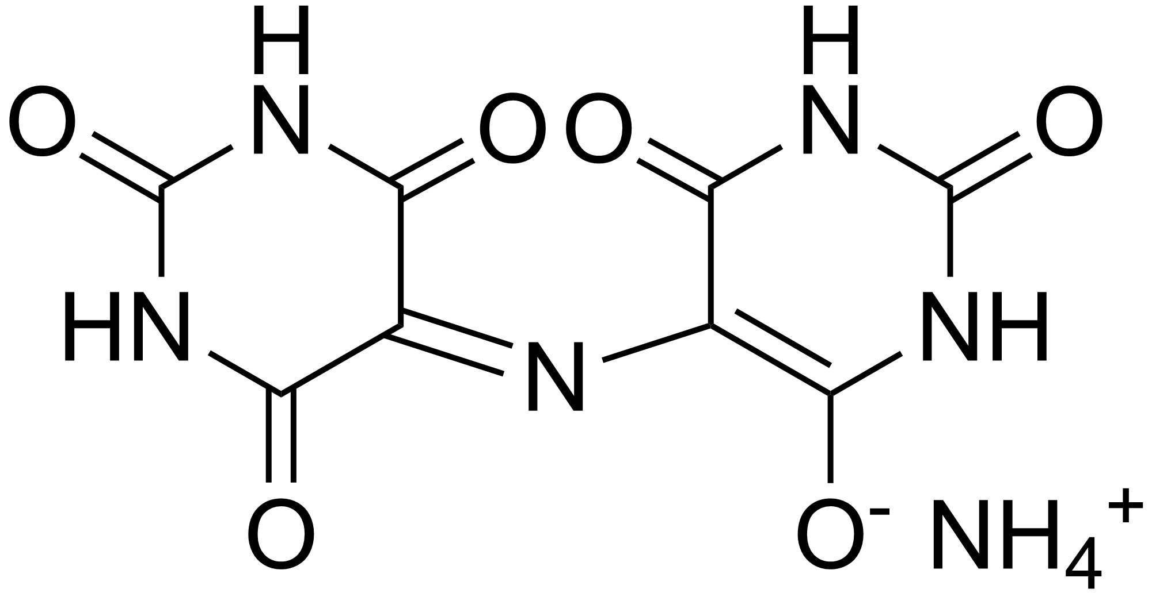
Required equipment
Tools:
- burette, pipette, titration flasks, graduated cylinder
Chemicals:
-chelaton 3, dampening ammonia solution, Eriochromium black T, NaOH, murexid indicator

Slide 10
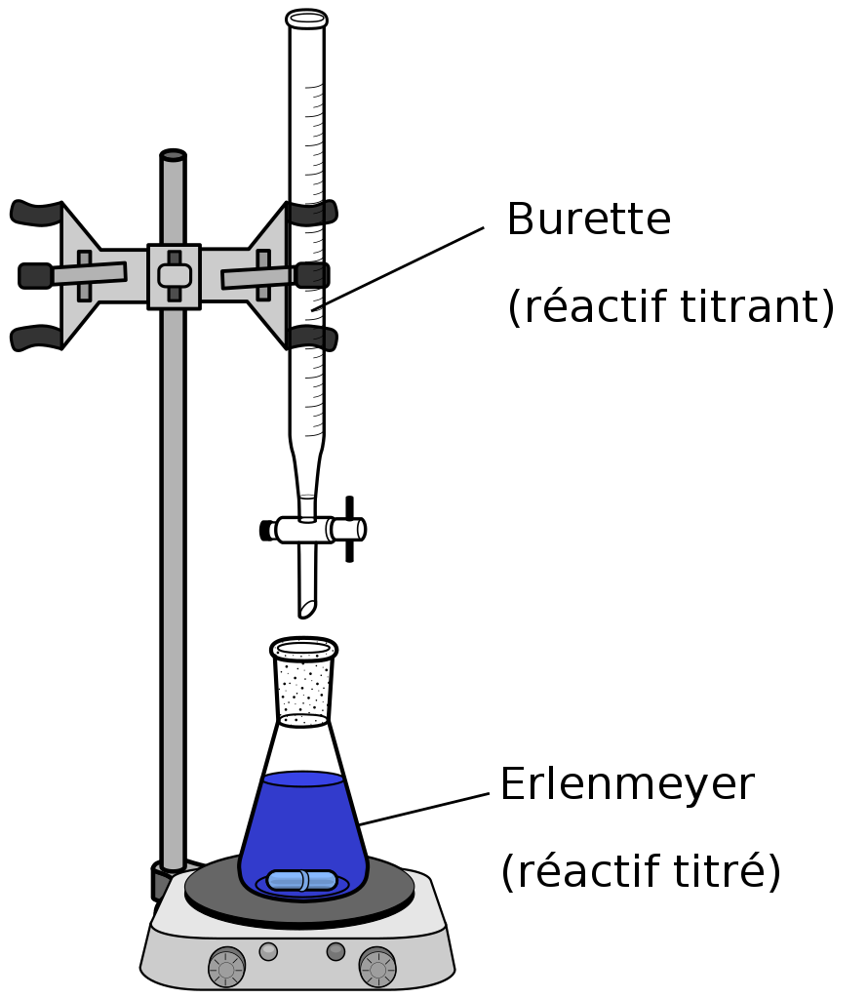
Process
(1) Prepare 250 ml of chelaton with the concentration of 0,05 mol.l⁻¹.
(2) Calculate the real concentration of chelaton.
(3) Pipette 100 ml of tested water into a titration flask.
(4) Add 5 of dampening ammonia solution by a graduated cylinder.
(5) Add a small amount of Eriochromium black T and titrate from wine red to blue colouring which lasts for 1 min.
(6) Determine 3x.
(7) Calculate water hardness in mmol.l⁻¹.

Slide 11

Calculation
m(g) = c * V * M m (real) = 4,6390 g V1 = 6,7 ml
m(g) = 0,05 * 0,25 * 372,24 V2 = 6,5 ml
m(g) = 4,653 g. V3 = 6,8 ml
Ø = 6,6 ml
c(real) = c(theoretical) * m(real) / m(theoretical)
c(real) = 0,05 * 4,6390/4,6530
c(real) = 0,04985 mol/l⁻¹.

Slide 12


Calculation
c = 0,04985 * 0,00666/0,1 * 1000 Ca: V1 = 5,3 ml
c = 3,3200 mmol.l⁻¹ V2 = 5,5 ml
V3 = 5,6 ml
c_{ca} = 0,04985 * 0,005466 / 0,1 * 1000 Ø = 5,466 ml
c_{ca} = 2,7248 mmol.l⁻¹
3,3200 – 2,7248 = 0,5952 mmol.l⁻¹
0,5952 * 24,30 = 14,46336 mg
2,7248 * 40 = 108,992 mg

Slide 13
THE END

