Slide 1
Determination of total water hardness via chelatometry
Kateřina Kochová, Richard Borsos

Slide 2
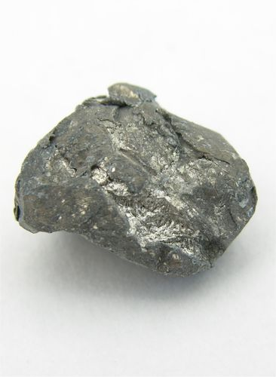
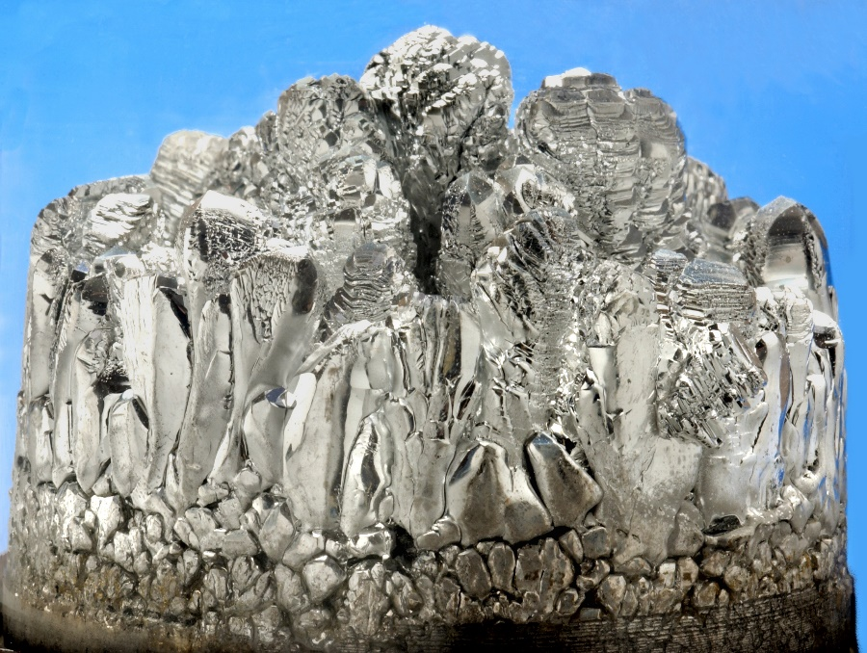
Our Task
Determine the total water hardness in mmol/l
Determine the content of calcium and magnesium in drinking water in mg/l.

Slide 3
Theory
Water hardness is caused not only by Ca²⁺ and Mg²⁺ salts in the water, but Sr²⁺ and Ba²⁺ salts too.
Water hardnes is determined via direct titration of volmetric solution chelaton 3 in the dampening ammonia solution using the Eriochromium black T indicator.
Water hardness | Water hardness in mol/l
Very soft | 0 - 0.7
Soft | 0.7 - 1.4
Medium soft | 1.4 - 2.1
Quiet hard | 2.1 - 3.2
Hard | 3.2 - 5.4
Very hard | > 5.4

Slide 4
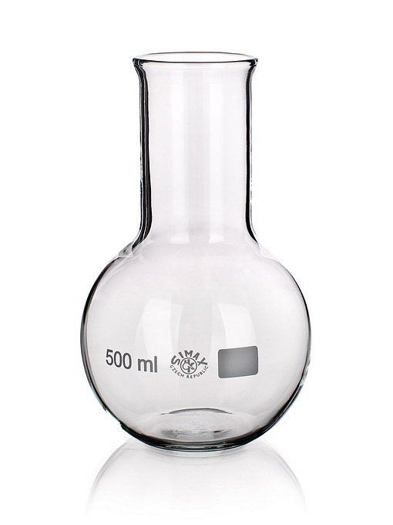
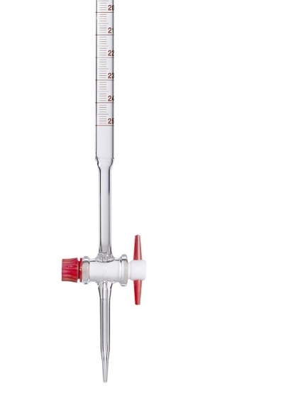
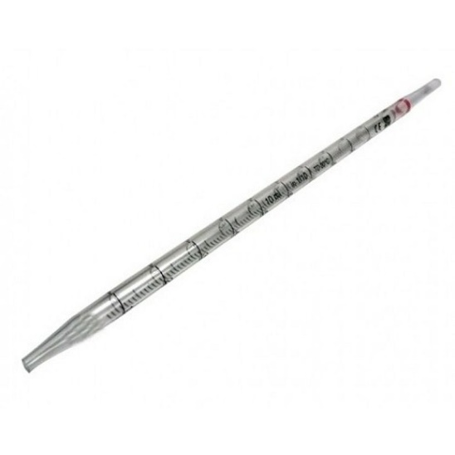
Tools and chemicals
We used: titration flask, burette and pipette
We also used Chaleton 3, Eriochromium black T, dampening ammonia solution, muraxid and sodium hydroxide

Slide 5
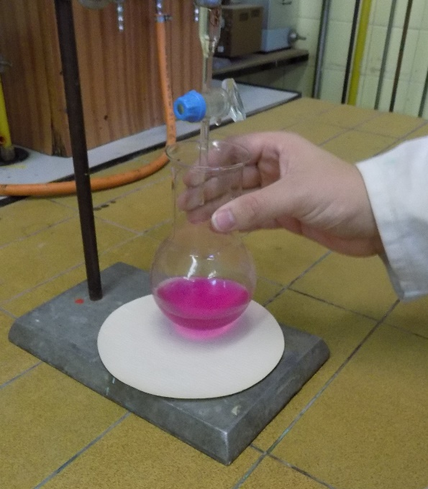
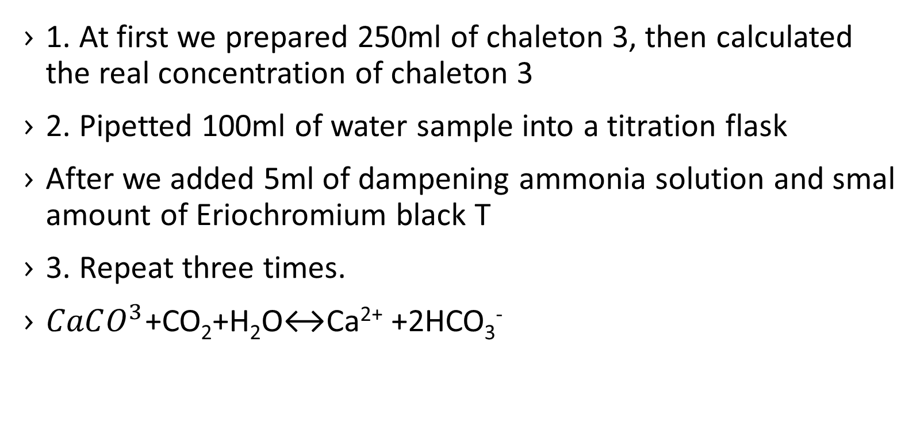
Procedure
1. At first we prepared 250ml of chaleton 3, then calculated the real concentration of chaleton 3
2. Pipetted 100ml of water sample into a titration flask
After we added 5ml of dampening ammonia solution and smal amount of Eriochromium black T
3. Repeat three times.
$CaCO^{3}$+CO₂+H₂O↔Ca²⁺ +2HCO₃⁻

Slide 6
Determination of Ca²⁺
To determinate Ca²⁺ we titrated calcium by volmetric solution chelaton 3 using murexid indicator in the diluted NaOH at pH12
To 100ml water sample we added NaOH and indicator after, we titrate it by 0,05M chelaton 3 to blue-violet coloring
At last we calculated the amount of Ca²⁺ in mol/l and in mg/l.
$${Ca}^{2+}+H_{2}Y^{2−}→CaY^{2−}+2H^{+}$$

Slide 7
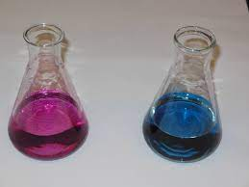
Determination of Mg²⁺
We detrmined it by calculating the difference of consumption using Eriochromium black T and murexid

Slide 8

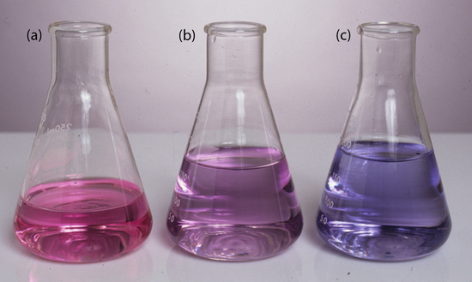
Results
Titration with Eriochromium balck T: it´s color changed from red wine to blue
Titration with murexid: it´s color changed from pink to purple

Slide 9

The End
Thank you for your patience

